Slide 1



Software Landing
AI Onboarding Assistant
Ariel Saadon

Slide 2

About Me
account_balance
Institution
Ariel University
account_circle
school
Degree
B.Sc. in Computer Science
edit_note
Personal Note
Passionate about programming, system architecture, and using AI to solve complex problems efficiently.
Ariel Saadon
Computer Science

Slide 3


John's Journey: The Friction of Onboarding
The Story of Day One
Meet John, a talented new hire at TechCorp. Instead of diving into code, his first week was a battle against silence and bureaucracy.
He was buried in massive PDF manuals, waiting hours for HR email replies just to perform basic tasks like booking a desk or finding the IT helpdesk.
Key Pain Points:
EventStream Delays: Technical lags meant answers took minutes, not seconds.
Tool Friction: Disconnected systems forced him to re-explain his issue multiple times.
Static Overload: Thousands of pages of documentation made finding one "truth" impossible.

Slide 4
Project Overview
report_problem
groups
smart_toy
auto_awesome
The Problem
The Users
The Solution
Why It's Useful
New employees spend valuable time searching through long documents, emailing HR, or waiting for IT — just to answer simple onboarding questions.
New hires at TechCorp on their first days — needing instant, reliable answers about HR, IT setup, and company culture.
An AI-powered chat portal that answers any onboarding question instantly, sourced directly from official TechCorp documentation using RAG.
24/7 availability
Accurate answers grounded in real documents
Reduces HR workload
Consistent experience

Slide 5
Technologies Used
Backend & Cloud
Frontend & Tools
code Python: Backend logic, AWS SDK (boto3), EventStream parsing
psychology RAG: Retrieval-Augmented Gen via Bedrock Knowledge Base
api Flask: REST API framework serving the frontend and `/ask` endpoint
web HTML / CSS / JS: Skeuomorphic office-desk UI design
cloud Amazon Bedrock: Agent orchestrates the RAG pipeline; Haiku fallback
touch_app UI Features: Tab navigation and dynamic ink-stamp graphics
layers Docker: Containerises the Flask app for consistency
account_tree Git / GitHub: Version control and repository management
dns AWS EC2: Hosts the containerised app publicly

Slide 6
Architecture Workflow
1
2
3
4
person
api
smart_toy
account_tree
User
Flask /ask
Bedrock Agent
RAG Pipeline
Enters a question in the browser chat interface
Receives the POST request, extracts session & question
Invokes agent via boto3; searches Knowledge Base
Retrieves relevant S3 document chunks
7
6
5
laptop_mac
sync_problem
psychology
Frontend
Fallback
LLM Gen
Response & citations rendered; contextual stamps added
If agent declines, Claude Haiku answers as general knowledge
Claude generates an answer grounded in retrieved docs

Slide 7

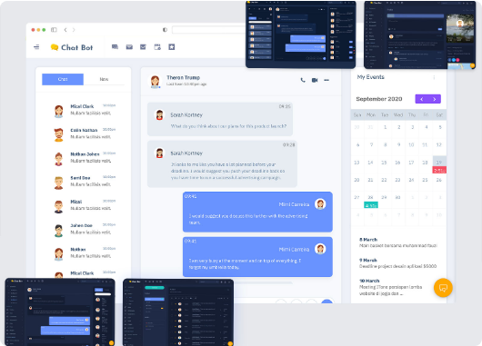
Live Demo
Open the App: Navigate to `localhost:5000` — the office-desk UI loads.
Ask a Question: Click the 'Knowledge Base' tab and ask: "How do I book a meeting room?"
Demonstrate RAG: The answer includes source citations from the company knowledge base.
Context Injection: Switch to 'Weather & Lunch'. Ask "What is the weather today?" Frontend invisibly prepends [Context: Weather].
Visual Stamps: A contextual holiday or weather stamp appears dynamically in the answer bubble based on parsing.

Slide 8
What Works Well
library_books
alt_route
account_tree
RAG with real documents
Bedrock Agent retrieves accurate, source-cited answers from the knowledge base; citations show the exact document source.
Intelligent Routing
The application dynamically analyzes the user's question to determine exactly which service, tool, or data source to invoke in real-time.
Agent + Fallback Chain
If the agent declines, the app silently retries with Claude Haiku via invoke_model, ensuring the user always gets a response.
psychology
layers
Multi-turn Memory
Session-based sessionId gives the agent full context across multiple questions without needing an external database.
Docker Containerisation
Runs identically locally and on EC2; credentials injected at runtime and never baked into the image for security.

Slide 9
What Was Technically Challenging
Architecture & Vision
One of the main challenges was maintaining the big picture throughout the entire development process — understanding the full architecture while still staying focused on solving the original problem. Balancing high-level system design with implementation details required continuous adjustments and careful planning.
terminal
sync_alt
EventStream Parsing
invoke_agent returns complex streams with chunk, trace, and returnControl types. Answer text is deeply nested, and citations are buried within retrievedReferences, requiring complex iteration to extract grounding data accurately.
Session Ownership Collision
Switching between APIs broke memory state as retrieve_and_generate returns IDs while invoke_agent expects them. Resolved by implementing custom caller-generated session IDs using hex tokens.

Slide 10
What Would Be Improved in the Next Version
Scalability & Modular Architecture
The primary goal is to allow any dataset uploaded as a RAG knowledge base to be automatically integrated as an application dataset. This enables the platform to support multiple organizations, each with its own customized dataset and knowledge domain, making the system adaptable to different companies and use cases.
vpn_key
User Authentication (SSO)
Integration of employee SSO to tie conversation history to unique identities rather than browser sessions, ensuring security and personalization.
history
Persistent Chat History
Storage of full chat threads allowing employees to resume previous discussions and providing HR with auditing capabilities for generated answers.
library_add
Expanded Knowledge Base
Automated S3 sync for benefits handbooks and org charts, ensuring the knowledge base stays current without requiring manual redeployments.
language
Multi-Language Support
Locale detection to prompt agent responses in native languages (London, Singapore, Warsaw), enhancing global accessibility for international offices.

